Slide 1


Strong Cryptoeconomic Security for Arbitrary Validation Tasks
Sreeram Kannan
Notes:
EigenLayer’s broad vision is to enable open innovation in the digital space in a scalable manner.
By scalability, we mean that not everyone has to do actual work in a digital task but anyone should be able to monitor and resolve if there are faults or violations in the work that is being done. This approach is similar to the requirement that is needed in any physical commons.
We recently released our whitepaper on our EIGEN token, which we envision as the tool for resolving faults in any digital task that are intersubjective in nature.

Slide 2
The Four Levels of Open Innovation
Application
App₁
App_{n}
Execution
Execution
Exec₁
Exec_{m}
Exec₁
Exec_{m}
Exec₁
Exec_{m}
Consensus
Consensus
Consensus
Consensus₁
Consensus_{n}
AVS – Actively Validated Services
Security
Security
Security
Shared Security (Staking)
Rollups
EigenLayer
Bitcoin
Ethereum
Notes:
To understand what intersubjectivity means, let’s first go through a short explanation on the taxonomy of digital tasks.
First and simplest to explain are those tasks with faults that are objectively attributable. Such faults can be accounted for purely in terms of mathematics and cryptography. Examples are EVM code execution and double signing.
However, there is a very broad class of tasks like data availability where faults are not provable on chain but is observable to any observer outside the chain and there is wide agreement among all honest observers. More such examples are whether 1BTC is equal to 1USD or is AI inference correct within a margin.
A common feature of both categories is that faults are widely agreed among the observers.
On the other hand subjective faults have no guaranteed agreement among observers. Examples are such as is paris the most beautiful city or what is the price of an nft in 1 year will havewide variation in opinions.
With EIGEN staking, we would typically want to resolve digital task with intersubjectvely attributable faults with automated execution.

Slide 3
Core Problem: Cryptoeconomic security
Validators commit stake
Opt in to performing tasks
These tasks are called “AVS”:
Actively Validated Services
Key question:
How to ensure nodes perform the tasks correctly?
Cryptoeconomic security
If nodes do not perform the task correctly, they will lose a measurable amount of deposit.
AVS-1
AVS-2
AVS-100
EigenLayer
….
Validators commit stake
Notes:
To understand what intersubjectivity means, let’s first go through a short explanation on the taxonomy of digital tasks.
First and simplest to explain are those tasks with faults that are objectively attributable. Such faults can be accounted for purely in terms of mathematics and cryptography. Examples are EVM code execution and double signing.
However, there is a very broad class of tasks like data availability where faults are not provable on chain but is observable to any observer outside the chain and there is wide agreement among all honest observers. More such examples are whether 1BTC is equal to 1USD or is AI inference correct within a margin.
A common feature of both categories is that faults are widely agreed among the observers.
On the other hand subjective faults have no guaranteed agreement among observers. Examples are such as is paris the most beautiful city or what is the price of an nft in 1 year will havewide variation in opinions.
With EIGEN staking, we would typically want to resolve digital task with intersubjectvely attributable faults with automated execution.

Slide 4
Attributability and security
Faults in digital tasks | Attributability | Examples | Security model
Objective faults | Proactively attributable | Deterministic Validity | ZK, CE
 | Retroactively attributable | Reorgs | CE
Intersubjective faults | Retroactively attributable | Oracle price feed, validity (without slashing contracts) | CE-New
 | Concurrently attributable | Data withholding, Censorship | CE-New
Non-attributable faults | None | Revealing secret shares
Notes:
Before I present our solution, let us understand the taxonomy of current mechanisms that are being used for resolving intersubjectively attributable faults
First one is majority voting where the stake of those operators whose response diverges from that of the majority by more than a certain margin are slashed.
Second one is to use a trusted committee to slash the stake of those operators whose responses are judged to be not true by the committee.
Naturally, both the solutions are vulnerable to tyranny of majority of the operators or the committee.
The third one is the slashing-by-forking. This is nominally used in proof-of-stake chains like Ethereum where social consensus is used to determine the canonical fork of the chain for resolving the intersubjective fault of no chain growth.
Using social consensus to resolve intersubjective faults amount to enabling free-choice to users in this unlimited ad unsized group of ecosystem stakeholders.

Slide 5
Four Types of Coordination Enforcement
Authoritarian
Majoritarian
Self-enforcing
Elitist
Robustness
increases
Notes:
Before I present our solution, let us understand the taxonomy of current mechanisms that are being used for resolving intersubjectively attributable faults
First one is majority voting where the stake of those operators whose response diverges from that of the majority by more than a certain margin are slashed.
Second one is to use a trusted committee to slash the stake of those operators whose responses are judged to be not true by the committee.
Naturally, both the solutions are vulnerable to tyranny of majority of the operators or the committee.
The third one is the slashing-by-forking. This is nominally used in proof-of-stake chains like Ethereum where social consensus is used to determine the canonical fork of the chain for resolving the intersubjective fault of no chain growth.
Using social consensus to resolve intersubjective faults amount to enabling free-choice to users in this unlimited ad unsized group of ecosystem stakeholders.

Slide 6



Slashing by forking in a Blockchain: Self-Enforcing
If a majority of validators sign an invalid block this is a problem.
The core solution to this problem: clients do not accept invalid blocks.
Thus the majority-signed block is forked, and the malicious validators are slashed (they lose their stake).
Note: this is only possible for the execution code that the clients validate.
Note: slashing only works for assets for which the blockchain is the final ledger of record.
Majority malicious
(tyranny-of-majority)
Any client
Notes:
Currently, slashing-by-forking is used only in the context of digital tasks pertaining to chain consensus.
Given that slashing-by-forking is not vulnerable to tyranny-of-majority, a natural question is how can it be extended to any intersubjectively attributable fault.
Next, does social consensus mean users have to meet in-person or in a discord channel? That would lead to a manual process for resolving faults which is not desirable. Instead it would be ideal to have the faults self-evident so that automated software can be be used to detect and resolve them.
In next few slides, we will go over the core ideas that make this possible with EIGEN

Slide 7
Cryptoeconomics for Arbitrary Tasks: Open Problem
Current mechanisms for resolving intersubjectively attributable faults
Majority voting
Committee
Slashing-by-forking
Slash the stake of operators who diverged from the majority
Use a “committee” to slash the operators whose responses are not “true”
Slash the stake by forking the chain
Social consensus: an unsized and limitless group
Vulnerable to tyranny-of-majority
Open Problem: How do we extend the cryptoeconomics to any intersubjectively attributable fault without forking the chain?
Notes:
Before I present our solution, let us understand the taxonomy of current mechanisms that are being used for resolving intersubjectively attributable faults
First one is majority voting where the stake of those operators whose response diverges from that of the majority by more than a certain margin are slashed.
Second one is to use a trusted committee to slash the stake of those operators whose responses are judged to be not true by the committee.
Naturally, both the solutions are vulnerable to tyranny of majority of the operators or the committee.
The third one is the slashing-by-forking. This is nominally used in proof-of-stake chains like Ethereum where social consensus is used to determine the canonical fork of the chain for resolving the intersubjective fault of no chain growth.
Using social consensus to resolve intersubjective faults amount to enabling free-choice to users in this unlimited ad unsized group of ecosystem stakeholders.

Slide 8
Core Idea 1: Setup & Execution Phase
Rules of coordination are codified
Fork on pre-agreed events that are self-evident.
Setup phase
Execution phase
Development timeline of any commons
Genesis of the system
Notes:
First core idea is the concept of setup phase and execution phase.
The setup phase for any intersubjective system requires establishing and codifying the set of rules that would be used for correct execution of a digital task and for coordinating an agreement among the observers about any fault in the execution.
Once the setup phase is over, it is execution phase where these pre-agreed rules are executed
These rules must be such that the faults are self-evident and self-verifiable by any user in the social consensus such that it precludes meeting in-person or in a discord channel.

Slide 9





Core Idea 2: Token forking
Ethereum blocks
EigenLayer
Observation
EIGEN
Value of a token arises from social consensus considering it as valuable
EigenLayer
Idea: Fork only token
EIGEN
Fork only token without forking the chain state and use social consensus to induce value to the token fork
Majority of EIGEN stakers turned malicious
EigenLayer
Malicious stakers are penalized by restricting them from being able to redeem tokens
$$EIGEN$$
$$\check{EIGEN}$$
Doesn’t overload Ethereum’s social consensus
EIGEN users
Notes:
The third core idea is token forking
A core observation in tokenomics is that value of a token arises from how much the social consensus of that token consider it to be valuable.
We can use this fact to fork just the token, without forking the chain state, to induce cryptoeconomic penalties on malicious stakers.
Consider this simple figure where EIGEN is being used for staking in EigenLayer.
If majority of EIGEN stakers were to turn malicious and cause an intersubjectively attributable fault, then a new fork of EIGEN, EIGEN-tilde will be spawned where the malicious stakers will be penalized by restricting them from being able to redeem the tokens from new fork.
As the new fork comes to be considered as canonical by the social consensus, the malicious stakers end up being penalized.
A core advantage by having EIGEN’s social consensus mediate on resolving the intersubjectivey attributable faults in AVSs is that now it doesn’t overload Ethereum’s social consensus anymore.

Slide 10
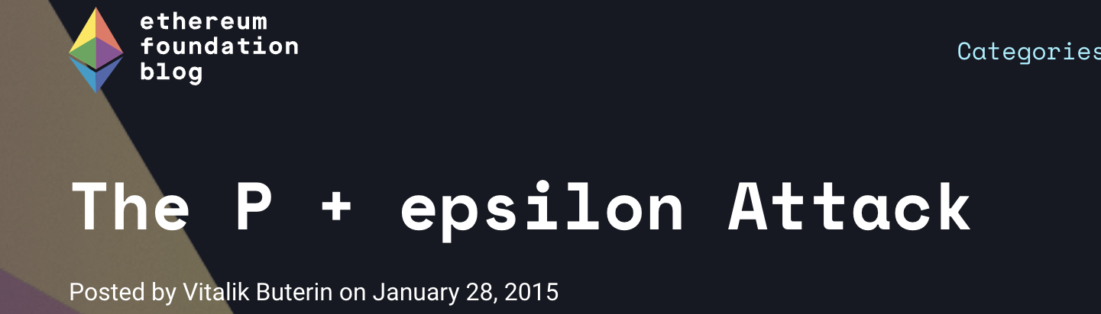
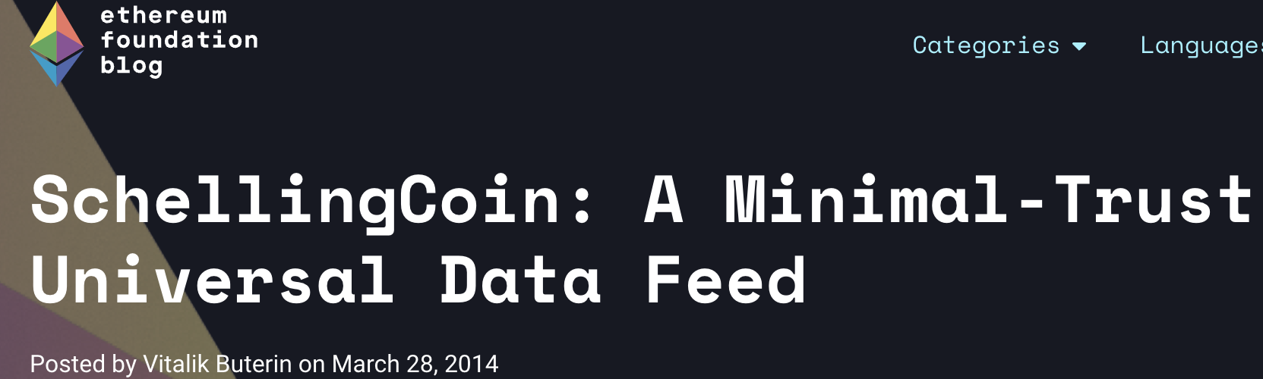
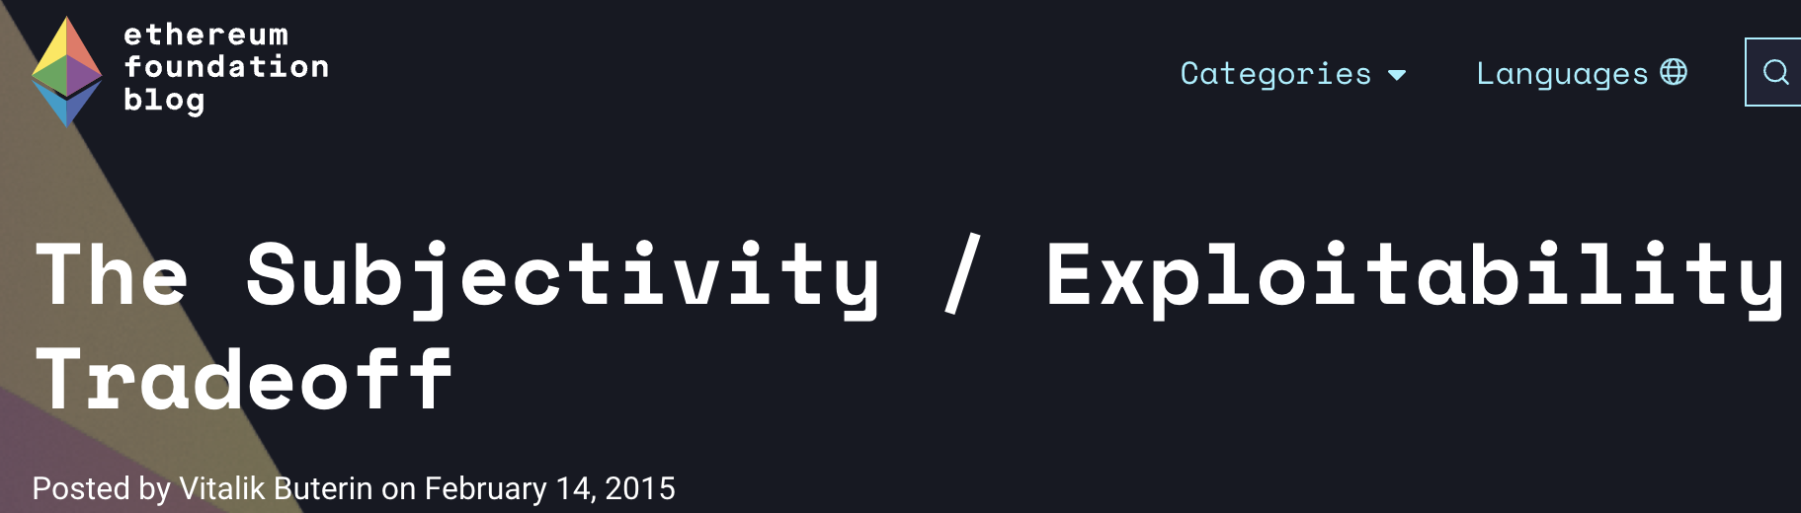
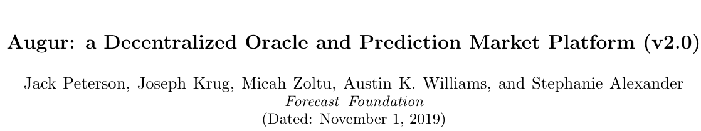
Prior work on token forking
Vitalik Buterin (circa 2014-2015)
Shortcomings
Specialization to measure profit-from-corruption for only prediction markets.
Every holder of REP token, even if not participating in the market, has to be fork-aware
Possible to build parasitic prediction markets, thus, making profit-from-corruption unknown
Notes:
Our approach to token forking in EIGEN builds upon some major prior work in this field.
Vitalik published a series of blogposts that explored the idea of forking and its game theoretic implications.
To our best knowledge, Augur built upon this work for their implementation of token forking in their REP token.
However, Augur’s implementation had three big shortcomings, which we resolve in EIGEN.
First one is Augur’ is specialized for measuring profit-from-corruption for only prediction markets
Second shortcoming is that every holder of REP token, even though they might not be participating in resolving faults in the prediction market, have to be aware of forks in REP token.
Third is that anyone can build parasitic prediction markets without being accounted in the measurement of cryptoeconomic security of Augur.

Slide 11
EIGEN: The Universal Intersubjective Work Token
Universality
Applicable to all intersubjective tasks
Isolation
Forking leads to externalities on DeFi
=> Need isolation between defi and staking / forking
Metering
Forking leads to social cost
=> meter and charge the social cost
Compensation
Malicious tasks lead to harm for dependent apps
=> Slash the malicious stakers and redistribute to harmed parties.
Solves long-standing open problems in crypto!
Notes:
With EIGEN, we get four core features, namely universality, isolation, metering and compensation that remove these shortcomings.
Next we will go over them one-by-one

Slide 12
Core feature 1: Universality
Setup phase for EIGEN stipulates that:
Token forking in EIGEN is now applicable to any intersubjective fault
AVSs must encode their rules for forking
Faults should be self-verifiable (intersubjective)
Notes:
In contrast to Augur, setup phase of EIGEN stipulates that EIGEN can be universally used for resolving any intersubjectively attributable and not just prediction markets
Second, any AVS who wants to use the cryptoeconomic benefits of EIGEN must encode their rules of coordination that they have agreed in their respective setup phase. These AVS-specific rule such as slashing conditions are akin to amendments to EIGEN.
Third, these slashing rules of the AVSs must ensure that any intersubjectively attributable fault is self-verifiable beyond a reasonable doubt.

Slide 13

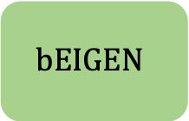
Core feature 2: Isolation
Undesirable design
Fork in token
DeFi markets have to be aware of fork
Token not usable for long-term positions
EIGEN’s design
Two token model
EIGEN
$$bEIGEN$$
Staking
DeFi
Isolation
(Unaware of forks)
(Aware of forks)
Notes:
Second core feature of EIGEN is isolation.
To appreciate this feature consider the design where any fork in the token would require defi markets to be aware of the fork and now token is not usable for going into long-term defi positions.
To avoid this undesirable consequenc, EIGEN has a two token model where token bEIGEN is used for staking and can be subjected to forking. On the other hand, any holder of EIGEN who is using this token for for DeFi or any non-stking applicatins can remais unaware of forks in bEIGEN.

Slide 14
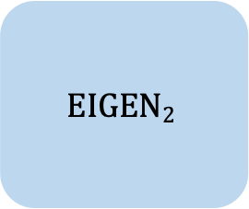
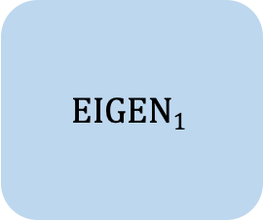
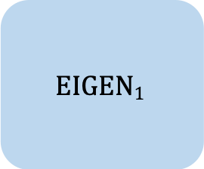
Core feature 3: Metering
$$EIGEN2$$
DPF = Deflation-per-fork
DPF burnt if EIGEN₂ is true
$$EIGEN1$$
DPF pays off social cost of
switching
$$EIGEN1$$
CPF = Commitment-Per-Fork
CPF burnt if EIGEN₁ is true
CPF pays off social cost of
rejecting malicious fork
Notes:
The third core feature is metering of the social cost of resolving any challenge.
First, a bond in bEIGEN denomination is required to raise challenge. This is necessary in order to cover the social cost of rejecting a malicious challenge.
Second, a minimum amount of bEIGEN stake has to be classified as malicious in the challenge. This is necessary to cover the cost of switching to the new fork in case of genuine challenge.

Slide 15
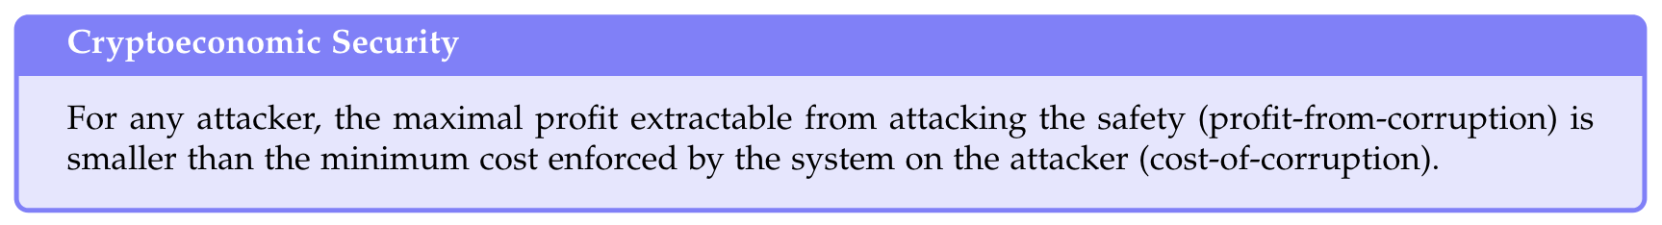
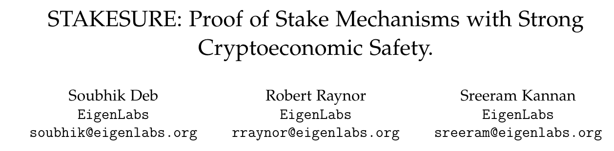
Core feature 4: Compensation
Traditional definition
Problems
No way to measure profit-from-corruption
Adversary can engage in parasitic behavior outside the system’s locus of measurement
Harmed user doesn’t get compensated for the value lost due to the attack
New definition
Strong Cryptoeconomic Security
For any user, Harm from Corruption < Insured Security
Notes:
Fourth core feature is compensation.
To appreciate it, we need to go through a short explanation of cryptoeconomic security.
The traditional definition of cryptoeconomic security just requires that maximum profit that is extracatable from attacking a system should be less than the cost of corrupting the system.
There are three major problems with this definition.
First one is there is no way to measure profit from corruption.
Second is an adversary can engage in a parasitic behavior outside the system’s locus of measurement.
Third is that a harmed user does’t get compensated for the value lost due to the attack.
In stakesure paper, we introduced a stronger definition of cryptoeconomic security with better guarantees, namely, any harmed user should be compensated apre-specified value in the event of an attack on the user.
With EIGEN, we guarantee strong cryptoeconomic security to achieve the feature of compensation.

Slide 16
EIGEN: The Universal Intersubjective Work Token
Universality
Applicable to all intersubjective tasks
Isolation
Forking leads to externalities on DeFi
=> Need isolation between defi and staking / forking
Metering
Forking leads to social cost
=> meter and charge the social cost
Compensation
Malicious tasks lead to harm for dependent apps
=> Slash the malicious stakers and redistribute to harmed parties.
Solves long-standing open problems in crypto!
Notes:
With EIGEN, we get four core features, namely universality, isolation, metering and compensation that remove these shortcomings.
Next we will go over them one-by-one

Slide 17
What new can you build now with EIGEN?
Gaming VMs
Any service that involves writing complex fraud proofs
Databases
and many more.
Intent, Order Matching, MEV engines
Data availability
Any service where faults are only observable from outside
Prediction markets
and many more.
Ordering service
AI Training, Benchmarking, Inference
Notes:
So what all you can build now with EIGEN
Any service that involves writing complex dispute resolution contracts can just instead accelerate their development phase by tapping into EIGEN as part of MVP.
Any service where faults are only observable from outside can be readily use EIGEN for resolving those faults. Examples bein …

Slide 18

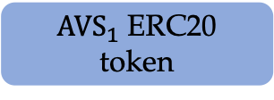

AVSs can mix-and-match ETH and EIGEN quorums
DApps
$$AVS_{1}$$
$$AVS_{i}$$
Execution
Restaking for resolving objectively attributable
faults
EigenLayer
Consensus
Staking for Intersubjectively
attributable faults
Staking
ETH token
$AVS_{1}$ ERC20 token
EIGEN token
Custom quorum
Decides on the
canonical fork of
EIGEN
Ethereum’s trust
network
Decides on the
canonical fork of
chain and ETH
EIGEN’s trust
network
Ethereum’s
Social consensus
EIGEN’s intersubjective
Social consensus
Notes:
With ETH restaking, ETH staked with Ethereum’s consensus used for resolving objtectivelly attributable faults.
With EIGEN stakng, EIGEN is being used for resolving intersubjective faults in AVSs., especially during the bootstrapping phase of AVSs
AVSs can also choose to have their own token quorum if they want additional security with customization.

Slide 19
Thanks!!!
Notes:
If you have cool ideas around what AVSs you can be built with EIGEN, we would love to talk with you.

Slide 20





Mechanics of compensation
Stake
Assumptions (for simplicity of explanation)
All operators have equal stake
They are all opted into 3 AVSs
Operator 4 and 5 behave maliciously and succeeds in harming AVS-1
$$γ_{3}$$
Stake redistributed to AVS-3
$$γ_{2}$$
Stake redistributed to AVS-2
Protocol for compensation:
All stake of operator 4 and operator 5 will be slashed as part of token forking.
A fraction of slashed stake is burnt.
A fraction of slashed stake gets redistributed to each of the AVSs to which the operators were opted into.
Stake redistributed to AVS-1
$$γ_{1}$$
$$γ_{burn}$$
Stake burnt
Operator 5
Operator 4
Operator 5
Operator 1
Operator 2
Operator 3
Operator 4
Operators
Both operators turn malicious
Burning $⟹$ Protection against griefing
Redistribution $⟹$ Compensation to harmed parties
Notes:
To explain the feature of compensation, we make the following assumptions for simplicity
All operators have equal stake
Each of these operators is opted into 3 AVSs
Operators 4 and 5 behave maliciously and succeeds in harming AVS-1
Now, as part of slashing-by-forking, operators 4 and 5 will be slashed as part of token forking.
Out of the slashed stake, a fraction of that stake is burnt.
The remaining slashed stake gets redistributed to each of the AVSs to which the operators had opted into.
In summary, burning protects against griefing while redistribution is used for compensating the harmed parties.

Slide 21
Taxonomy of Digital Tasks
Scope
Low
agreement
High
agreement
Kleros
(Manual system of jurors)
Subjective faults
Intersubjectively attributable faults
Examples:
Is 1 BTC = 1 USD ?
Is data available?
Is AI inference right?
No guaranteed agreement among observers
Broad agreement among external observers
EIGEN staking
Examples
Is Paris the most beautiful city?
What will be the price for an NFT in 1 year?
Execution speed
Manual
Objectively
attributable faults
Examples:
EVM code execution
Double signing
Purely mathematical and cryptographic
Automated
Agreement
Notes:
To understand what intersubjectivity means, let’s first go through a short explanation on the taxonomy of digital tasks.
First and simplest to explain are those tasks with faults that are objectively attributable. Such faults can be accounted for purely in terms of mathematics and cryptography. Examples are EVM code execution and double signing.
However, there is a very broad class of tasks like data availability where faults are not provable on chain but is observable to any observer outside the chain and there is wide agreement among all honest observers. More such examples are whether 1BTC is equal to 1USD or is AI inference correct within a margin.
A common feature of both categories is that faults are widely agreed among the observers.
On the other hand subjective faults have no guaranteed agreement among observers. Examples are such as is paris the most beautiful city or what is the price of an nft in 1 year will havewide variation in opinions.
With EIGEN staking, we want to resolve digital taks with intersubjectvely attributable faults with automated execution instead of a manual selection of jurors as was done in kleros.

Slide 22
Examples of Setup & Execution Phase
Phases
Setup phase: Pre-agree on a rule
Execution phase: Execute the rule
US Gov.
US Constitution
Laws passed compliant with constitution
PoW consensus
Longest-chain rule (LCR)
Decide on latest block (per LCR)
Weak subjectivity
Weak subjectivity checkpoint rule
Computation of weak subjectivity checkpoint
Rollup
Follow bridge contract
Decide on current rollup block (using bridge state)
Sovereign Rollup
Example: Follow social consensus to revert hacks
Decide on current rollup block (using social consensus)
Notes:
An example of setup phase is the ratification of US constitution and now in the execution phase any law passed has to be compliant with the constitution.
An example of setup phase in the context of blockchains is longest-chain consensus rule which is then used for determining the latest block in bitcoin.
There more such examples in the context of blockchain such as weak subjectivity and rollups, which we state in the whitepaper.

